Slide 1
Quality performance indicators for 2016 ( vs.2015)
MM/ 03/01/2016

Slide 2
Quality performance 2016 vs 2015
PERFORMANCE 2015/2016
DEPARTMENT | NCR'S |  | CUSTOMER COMPLAINTS |  | COST OF NON-QUALITY |  |  |  | TARGET | audit results after follow-up |  | TARGET | OTD av. |  | TARGET
 | 2015 | 2016 | 2015 | 2016 | 2015 | % | 2016 | % |  | 2015 | 2016 |  | 2015 | 2016
WEC ENGINEERING | 187 | 175↘ | 37 | 23↘ | £33,954 | 0.40% | £42,741 | 0.6%↗ | 1% | 83.94% | 83.52%→ | 80% | 77% | 69% | 80%
WEC MACHINING CENTRE | 31 | 44 ↗ | 10 | 2↘ | £7,063 | 1% | £14,706 | 4.5%↗ | 1% | 78.00% | 88%↗ | 80% | not monitored |  | 80%
WEC CCTV | 85 | 78 ↘ | 24 | 30↗ | £13,808 | 0.30% | £9,687 | 0.3%→ | 1% | 92.00% | 91%→ | 80% | not monitored |  | 80%
WEC LASER | 493 | 583↗ | 525 | 339↘ | £161,280 | 1.60% | £101,252 | 0.4%↘ | 1% | 86.00% | 88.31%↗ | 80% | 75% | 79% | 80%
WEC JET | 13 | 12↘ | 16 | 10↘ | £3,237 | 0.01% | £2,172 | 0.2%↗ | 1% | 91.14% | 77.96%↘ | 80% | 87% | 91% | 80%
WEC 5750 | 169 | 178↗ | 115 | 121↗ | £24,437 | 0.74% | £43,077 | 0.7%→ | 1% | 82.88% | 81.64%→ | 80% | 70% | 81% | 80%
SP.PROJECTS | 101 | 82↘ | 29 | 27→ | £52,809 | 2.90% | £12,750 | 0.8%↘ | 1% | 76.67% | 72.96%↘ | 80% | 73% | 80% | 80%
WEC SHERBURN | 107 | 88↘ | 17 | 15→ | £4,874 | 0.13% | £3,282 | 0.11%→ | 1% | 84.42% | 71.86%↘ | 80% | not monitored |  | 80%
WEC MACHINING | 263 | 269→ | 60 | 68↗ | £34,745 | 0.80% | £58,235 | 1.7%↗ | 1% | 79.31% | 77.05%↘ | 80% | 52% | 80% | 80%

Slide 3
NUMBER OF NCR’S RAISED
NUMBER OF NCR'S RAISED
Divison | engineering | machining centre | cctv | laser | wec jet | 5750 | sp.projects | sherburn | machining
2015 | 187 | 31 | 85 | 493 | 13 | 169 | 101 | 107 | 263
2016 | 175 | 44 | 78 | 583 | 12 | 178 | 82 | 88 | 269

Slide 4
CUSTOMER COMPLAINTS
CUSTOMER COMPLAINTS
Divison | engineering | machining centre | cctv | laser | wec jet | 5750 | sp.projects | sherburn | machining
2015 | 37 | 10 | 24 | 525 | 16 | 115 | 29 | 17 | 60
2016 | 23 | 2 | 30 | 339 | 10 | 121 | 27 | 15 | 68

Slide 5
COST OF NON-QUALITY
COST OF NON-QUALITY
Divison | engineering | machining centre | cctv | laser | wec jet | 5750 | sp.projects | sherburn | machining
2015 | 0.40% | 1.00% | 0.30% | 1.60% | 0.01% | 0.74% | 2.90% | 0.13% | 0.80%
2016 | 0.60% | 4.50% | 0.30% | 0.40% | 0.20% | 0.70% | 0.80% | 0.11% | 1.70%

Slide 6
IMPROVEMENTS REGISTERED
Performance improvement
DECREASE OF TOTAL NON-QUALITY COST WITH 14%
DECREASE OF CUSTOMER COMPLAINTS WITH 38%
System ACHIEVEMENTS
Aerospace certification to AS9100 ( aerospace)
Accreditation to EN 1090 for Sherburn
Accreditation to EN 1090 for HTA
Customer approvals – Rolls Royce Nuclear
Customer re-qualification - Bombardier

Slide 7
Number of Non-conformance reports
2015
2016

Slide 8
NCR’s per type of complaints- 2015

Slide 9
NCR’s per type of complaints -2016

Slide 10
Root causes identified 2016
DEPARTMENT | customer | equipment | missing documentation | system | supplier | training | transport | work conditions
CCTV | 2 | 0 | 2 | 5 | 18 | 35 | 2 | 5
ENGINEERING | 1 | 2 | 6 | 15 | 35 | 98 | 1 | 1
MACHINING CENTRE | 0 | 2 | 2 | 1 | 3 | 34 | 0 | 0
LASER | 5 | 13 | 2 | 16 | 52 | 327 | 5 | 29
WEC JET | 1 | 1 | 0 | 0 | 2 | 2 | 0 | 0
WEC MACHINING | 16 | 19 | 5 | 18 | 60 | 125 | 1 | 2
SP.PROJECTS | 4 | 3 | 8 | 6 | 15 | 28 | 1 | 8
LIVERPOOL | 1 | 5 | 10 | 1 | 8 | 152 | 1 | 2
SHERBURN | 0 | 3 | 1 | 0 | 45 | 7 | 0 | 0
QUALITY | 0 | 4 | 4 | 100 | 2 | 62 | 0 | 6

Slide 11
Internal audit results
 | 2015-2016
division | INTERNAL AUDIT SCORE% ( INITIAL ASSESSMENT)2015 | INTERNAL AUDIT SCORE% ( INITIAL ASSESSMENT)2016 | INTERNAL AUDIT SCORE% ( follow-up )2015 | INTERNAL AUDIT SCORE% ( follow-up)2016
WEC MACHINING | 70.27 | 70.9 | 79.31 | 77.05
CCTV | 89.36 | 86.71 | 91.92 | 90.91
SP.PROJECTS | 69.29 | 73.84 | 76.67 | 72.96
LASER | 81.71 | 86.57 (83.43) | 86 | 88.31
ENGINEERING | 82.5 | 83.76 | 83.94 | 83.52
MACHINING CENTRE | 79.6 | 80.74 | 78.07 | 88.3
CENTRAL FUNCTIONS | 78.75 | 70.56 | 91.67
WEC RAIL | 81.03 | 77
SHERBURN | 84.42 | 82.56 |  | 71.86
HTA |  |  |  | 83.73
WEC JET | 86.57 | 72.71 | 91.14 | 77.96
LIVERPOOL( 5750) | 81.19 | 83.73 | 82.88 | 81.64
target |  | 100 |  | 100

Slide 12
Main audit findings

Slide 13
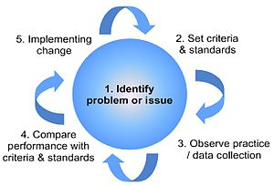
Quality program continues for 2017
Weekly meetings for NCR’s review with Engineering, Sp.Projects, Machining, Laser
Standardise the cost of non-quality collection
Weekly Quality meetings with quality team
Monthly Quality meetings with departments
Internal audit to the planning
Audits and police-ing on shop floor
Root cause analysis
Finding solutions for continuous improvement
Tool box talks on quality to the Quality Alert boards with shop floor and people producing non-quality
Risk base thinking
Implement 6 S

Slide 14
OTD per division

Slide 15
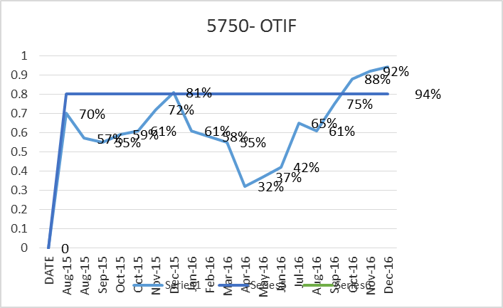
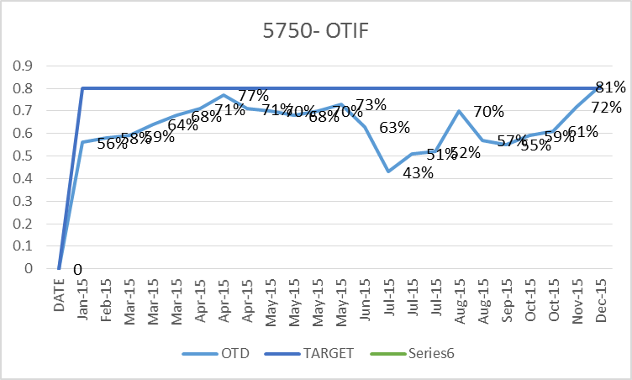
5750
2016
2015

Slide 16
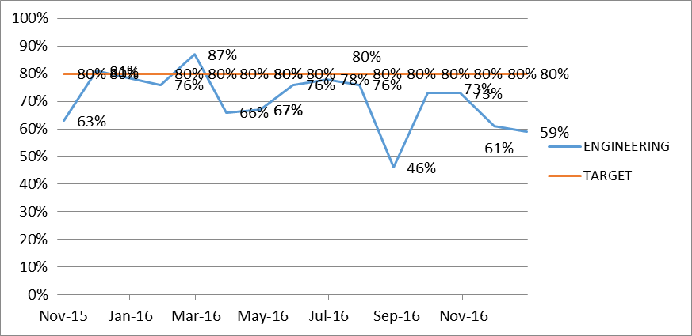
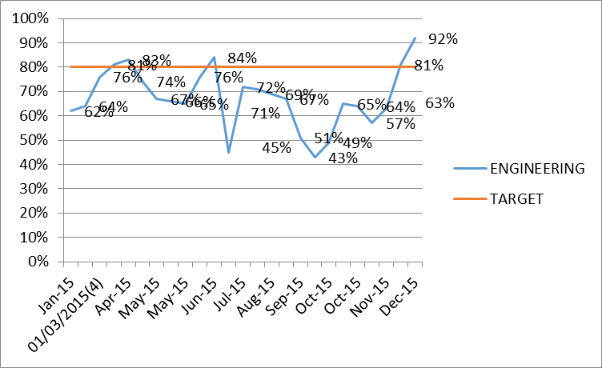
Engineering
2016
2015

Slide 17
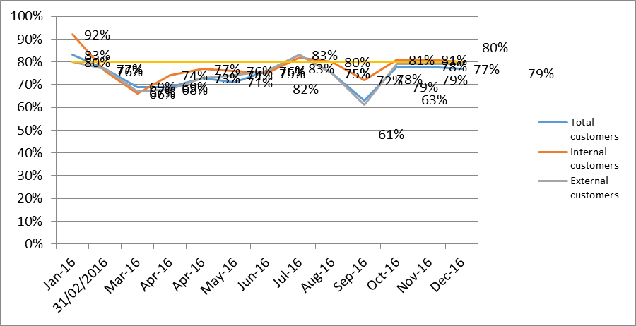
Laser
2016
2015

Slide 18
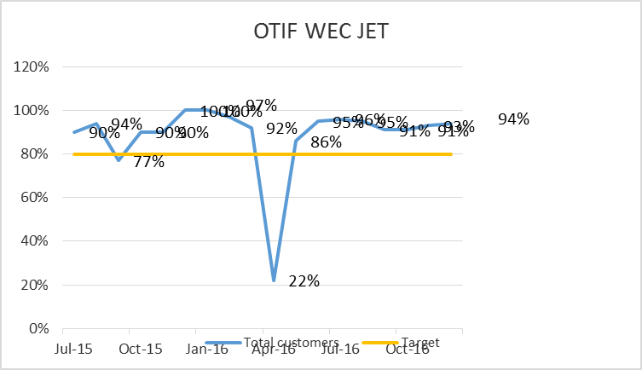
WEC JET
2016
2015

Slide 19
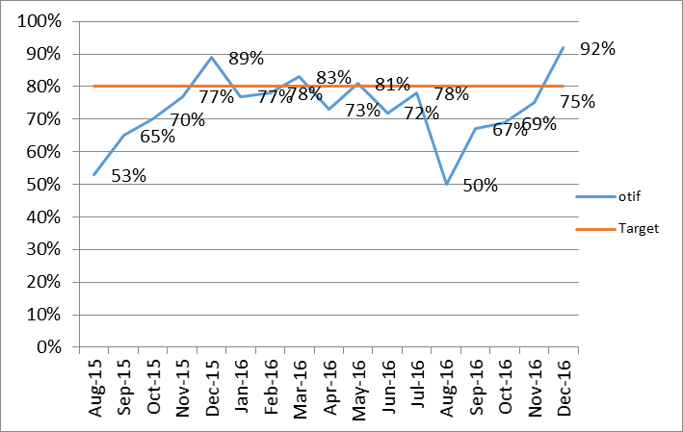
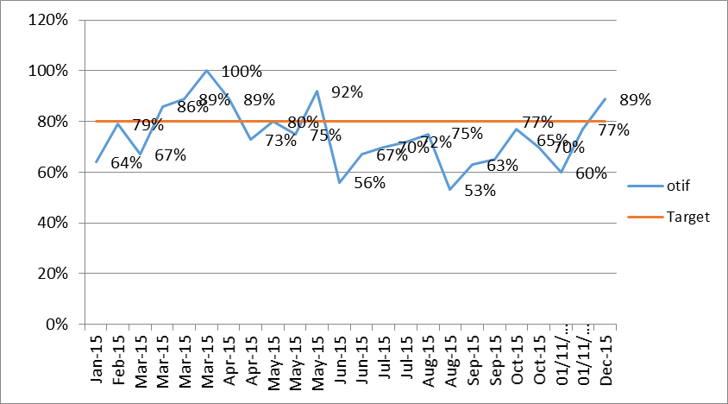
Sp.Projects
2016
2015

Slide 20
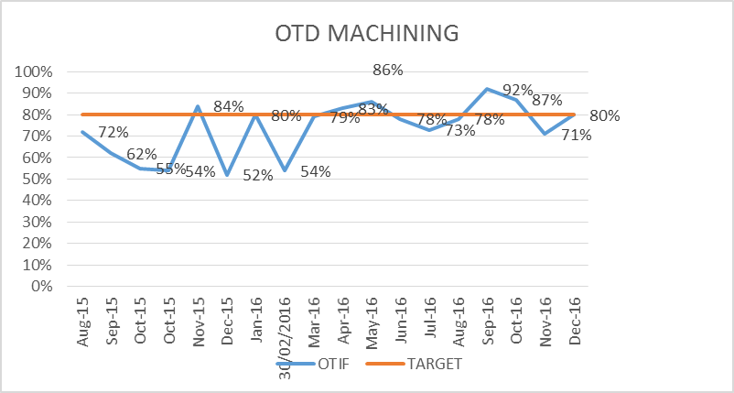
Machining
2016
2015

