Slide 1
Quality performance indicators for 2017 ( vs.2016)
MM/ 03/01/2018

Slide 2
Quality performance 2017 vs 2016
PERFORMANCE 2017/2016
DEPARTMENT | NCR'S |  | CUSTOMER COMPLAINTS |  | COST OF NON-QUALITY |  |  |  | TARGET | audit results after follow-up |  | TARGET | OTD |  | TARGET
 | 2017 | 2016 | 2017 | 2016 | 2017 | % | 2016 | % |  | 2017 | 2016 |  | 2017 | 2016
WEC ENGINEERING | 212↗ | 175 | 35↗ | 23 | £38,008 | 0.2%↘ | £42,741 | 0.60% | 1% | 84.20% | 84% | 80% | 57%↘ | 92% | 80%
WEC MACHINING CENTRE | 15↘ | 44 | 4↗ | 2 | £3,774 | 0.4%↘ | £14,706 | 4.50% | 1% | 90.91%↗ | 88.00% | 80% | not monitored |  | 80%
WEC CCTV | 68↘ | 78 | 35↗ | 30 | £11,978 | 0.3%↘ | £9,687 | 0.30% | 1% | 92%↗ | 91.00% | 80% | not monitored |  | 80%
WEC LASER | 515↘ | 583 | 299↘ | 339 | £99,357 | 0.6%↗ | £101,252 | 0.40% | 1% | 86%↘ | 88.31% | 80% | 87%↘ | 88% | 80%
WEC JET | 8↘ | 12 | 5↘ | 10 | £4,591 | 0.1%↘ | £2,172 | 0.20% | 1% | 81%↗ | 77.96% | 80% | 86%↘ | 94% | 80%
WEC 5750 | 285↗ | 178 | 209↗ | 121 | £65,092 | 0.70% | £43,077 | 0.70% | 1% | 87%↗ | 81.64% | 80% | 92%↘ | 94% | 80%
SP.PROJECTS | 67↘ | 82 | 26↘ | 27 | £13,110 | 0.34%↘ | £12,750 | 0.80% | 1% | 87.67%↗ | 72.96% | 80% | 50%↘ | 92% | 80%
WEC SHERBURN | 78↘ | 88 | 24↗ | 15 | £17,889 | 0.5%↗ | £3,282 | 0.11% | 1% | 81%↗ | 71.86% | 80% | not monitored |  | 80%
WEC MACHINING | 253↘ | 269 | 58↘ | 68 | £35,904 | 1%↘ | £58,235 | 1.70% | 1% | 84%↗ | 77.05% | 80% | 89%↗ | 80% | 80%
 | 1502 | 1714 | 696 | 637 | £289,703 |  | £298,452
 | decrease with 12% |  | increase with 8% |  |  | decrease with 3% |  |  |  | all processes over 80 % ( qualified) |  |  | all OTD down

Slide 3
NUMBER OF NCR’S RAISED
Divison | engineering | machining centre | cctv | laser | wec jet | 5750 | sp.projects | sherburn | machining
2017 | 212 | 15 | 68 | 515 | 8 | 285 | 67 | 78 | 253
2016 | 175 | 44 | 78 | 583 | 12 | 178 | 82 | 88 | 269

Slide 4
CUSTOMER COMPLAINTS
Divison | engineering | machining centre | cctv | laser | wec jet | 5750 | sp.projects | sherburn | machining
2017 | 35 | 4 | 35 | 299 | 5 | 209 | 26 | 24 | 58
2016 | 23 | 2 | 30 | 339 | 10 | 121 | 27 | 15 | 68

Slide 5
Cost of NON-QUALITY 2017
COST OF NON-QUALITY
Divison | engineering | machining centre | cctv | laser | wec jet | 5750 | sp.projects | sherburn | machining
2017 | 0.20% | 0.40% | 0.30% | 0.60% | 0.10% | 0.70% | 0.34% | 0.50% | 1.00%
2016 | 0.60% | 4.50% | 0.30% | 0.40% | 0.20% | 0.70% | 0.80% | 0.11% | 1.70%

Slide 6
Root causes identified 2016/ 2017

Slide 7
Root causes 2017

Slide 8
Internal audit results
 | 2016-2017
division | INTERNAL AUDIT SCORE% ( INITIAL ASSESSMENT)2016 | INTERNAL AUDIT SCORE% ( follow-up)2016 | INTERNAL AUDIT SCORE% ( INITIAL ASSESSMENT)2017 | INTERNAL AUDIT SCORE% ( follow-up)2017
WEC MACHINING | 70.9 | 77.05 | 73.72 | 83.59
CCTV | 86.71 | 90.91 | 88.35 | 91.61
PAINT SHOP |  | PART OF CCTV |  | 95.76
SP.PROJECTS | 73.84 | 72.96 | 74.81 | 87.67
LASER | 86.57 (83.43) | 88.31 | 77.53 | 85.67
POWDER COATING PLANT( LASER) |  | PART OF LASER |  | 83.43
ENGINEERING | 83.76 | 83.52 | 81.82 | 84.2
MACHINING CENTRE | 80.74 | 88.3 | 82.62 | 90.91
CENTRAL FUNCTIONS | 70.56 |  | 85.22
WEC RAIL | 77 |  | 88
SHERBURN | 82.56 | 71.86 | 50.47 | 81
HTA |  | 83.73 | 89.79 | 92.61
WEC JET | 72.71 | 77.96 | 87.08 | 81
LIVERPOOL( 5750) | 83.73 | 81.64 | 81.9 | 86.97
TRAINING ACADEMY |  | 80 |  | 81.6
target | 100 | 100 | 100 | 100

Slide 9
Main audit findings
Better results in all departments . Scoring >80% compliance to system requirements

Slide 10
IMPROVEMENTS REGISTERED
Performance improvement
DECREASE OF TOTAL NON-QUALITY COST WITH 3%
Excluding the trend in 5750 caused by the move in the new location – we had less customer complaints with 5%
ALL PROCESSESS QUALIFIED VIA AUDIT ( RESULTS OVER 80%)
Quality new resource in Engineering
More new customers enquiries on quality system ( customer questionnaires) with 20% ( 123 new customers in 2017 / 100 in 2016)
System ACHIEVEMENTS
Aerospace re-certification to AS9100 ( aerospace)
Accreditation to Scheme 19A for coating processes
Customer approvals – Selafield ( via Hertel)
Certification to EN 15085 for fabrication processes ( for welding on rail vehicles)

Slide 11
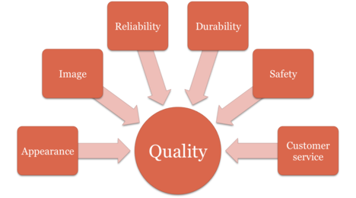
Quality program continues for 2017
Vision : Going forward
Mission – raise the level of quality& culture

Slide 12
New Program 2018- Continuity-Consistency-Performance
Maintaining certifications ( from 6 months - audits quarterly)
Gaining more accreditations in interest zones ( aerospace for fabrication, NADCAP)
Maintaining and updating Manuals ( QA Manual, Safety Manual, Welding Manuals)
Keep up with Quality meetings
Focus on cost of non-quality
Focus on root cause analysis
Expand awareness on quality
Expand communication
Introduce QUALITY AWARDS
CHANGE COMPANY CULTURE

Slide 13
New Dashboard
DEPARTMENT/ TEAM | NR.OF NCR/WEEK | NR. AUDITS /WEEK | ATTENDANCE TO THE MEETING
LASER ( JB)
SP.PROJECTS (SK)
MACHINING (BB)
ENGINEERING ( WT)
5750 (SC)
SYSTEM ( MM)
RATE OF NCR%
DEPARTMENT | JAN | FEB | MARCH
CONQ%
DEPARTMENT | JAN | FEB | MARCH

Slide 14
OTD per division

Slide 15
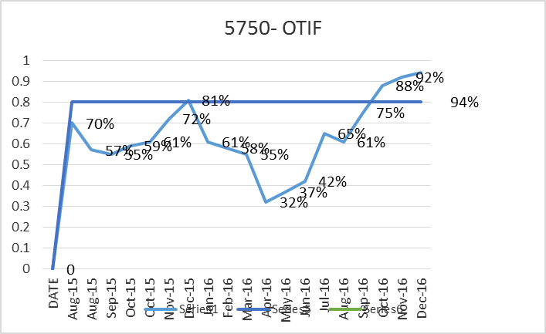
5750
2016
2017 ↗

Slide 16
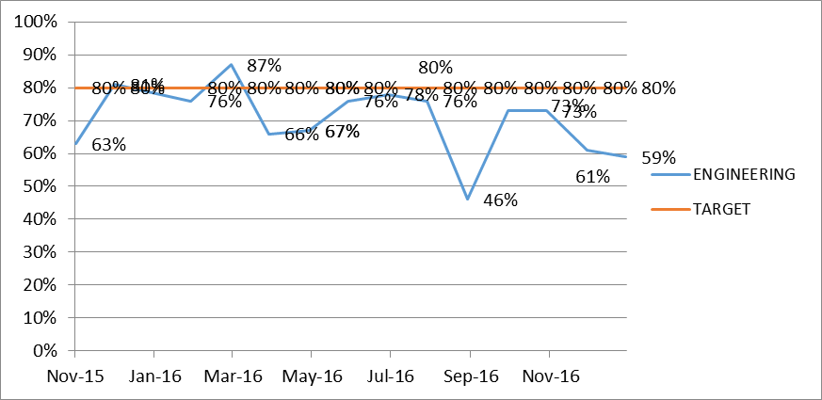
Engineering
2016
2017↘

Slide 17
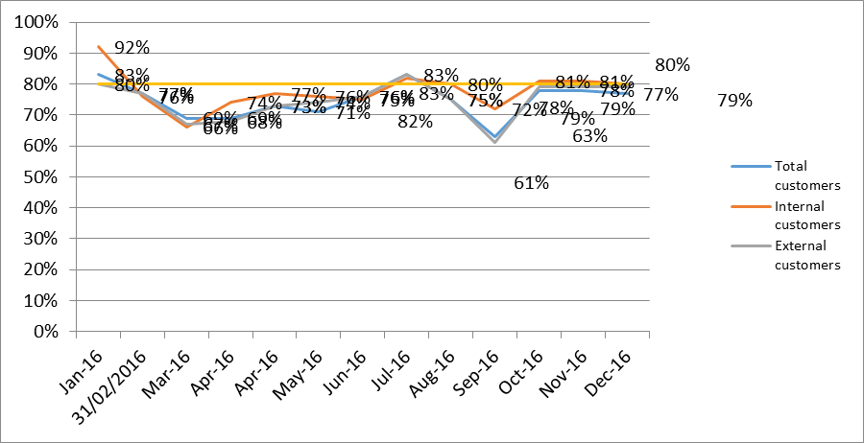
Laser
2016
2017↗↗

Slide 18
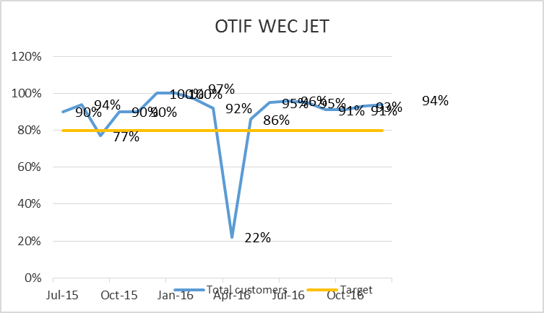
WEC JET
2016
2017↘

Slide 19
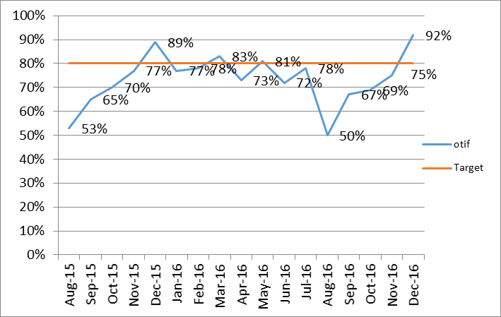
Sp.Projects
2016
2017↘

Slide 20
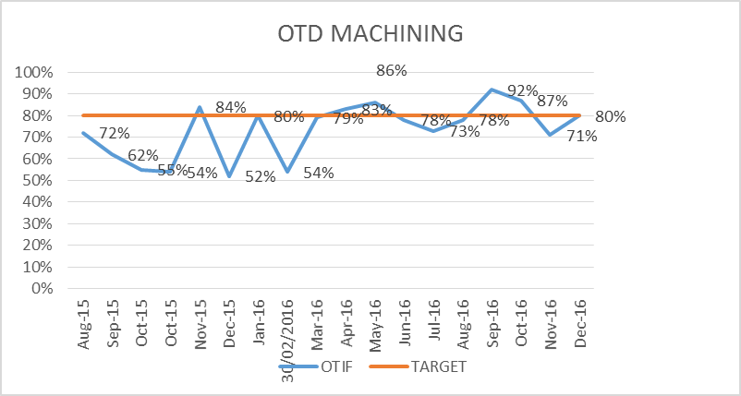
Machining
2016
2017↗

