Slide 1
Microsoft® Excel® 2010 Training
Keyboard shortcuts 2: ALT key shortcuts
Notes:
[Notes to trainer:
This presentation must be viewed in PowerPoint 2010. If you don’t have PowerPoint 2010, the videos included in the presentation will not play. If you don’t have PowerPoint 2010, download the PowerPoint Viewer to view these files (http://www.microsoft.com/downloads/details.aspx?displaylang=en&FamilyID=cb9bf144%2D1076%2D4615%2D9951%2D294eeb832823).
If the yellow security bar appears at the top of the screen in PowerPoint, or if a Codec Unavailable message appears in the video playback window, the presentation might have opened in Protected View. To enable video playback, in the yellow security bar at the top of the PowerPoint window, click Enable Editing.
To browse other downloadable [Product Name] training presentations, see the “Download Office 2010 training” page (http://office.microsoft.com/en-us/powerpoint-help/download-office-2010-training-HA101901726.aspx).
For detailed help in customizing this template, see the very last slide. Also, look for additional lesson text in the notes pane of some slides.]

Slide 2
Course contents
Overview: Use access keys in Excel 2010
Lesson: Includes 4 instructional movies
Quick Reference Card

Slide 3

Overview: Use the ALT shortcuts
The ALT keyboard shortcuts let you use almost all of the commands available on the ribbon. These shortcuts are also called access keys.

Slide 4
Course goals
Use the ALT key to access any button or command on the ribbon.
Use old ALT key shortcuts that worked in older versions of Excel.
Use ALT key shortcuts in dialog boxes.
Use other kinds of access keys, like F6.

Slide 5
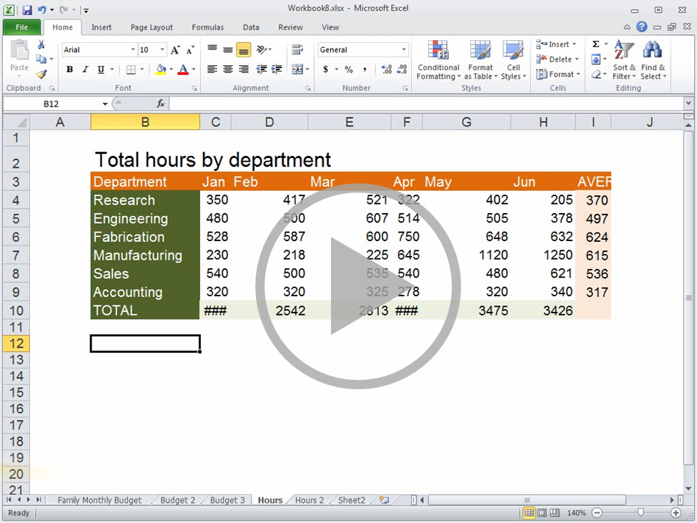
Introduction (3:29)
Access keys are easy to use because you don’t need to memorize much. You just look at the key tip and press the key.
In the first course we showed you how keyboard shortcuts can save you time.
Now we’re going to show you how to use access keys, a special kind of keyboard shortcut.
Access keys lets you access a tab, button or menu, that may not have a CTRL shortcut.
For example, there's no CTRL shortcut for auto fitting column width.
So to access this command without the mouse, you first press ALT.
When you do that, key tips appears on the Ribbon, they show you which key to press to select an item,
For example, H selects the Home tab, O selects Format, and then I selects AutoFit Column Width.
For example, if you go to the Home tab, you’ll notice that the Center Alignment button has two keys.
Press one, then the other. In this example you press A, then C .
If you’re searching for a command, you don’t have to worry about getting stuck,
If you’re really lost, you can keep pressing ESC, and you'll eventually exit access key mode.
First, press ALT, the Right and Left Arrow keys move you horizontally.
The Up key moves you to the Quick Access toolbar, and the Down key takes you to the commands on the Ribbon.
When you arrive at the button you would normally click with the mouse, press Enter.
then press ESC to back out, or press Enter to select a command or option.
press SHIFT+TAB to move backward and press Enter to select an item.
You can also use a combination of Arrow and Tab keys for moving around in the Ribbon.
So, that’s how to use the ALT key to access tabs, buttons, and menus.
Next, you’ll see how access keys from previous versions of Excel work.
just like clicking it with the mouse.
What if the key tips shows two keys ?
because you can always back out by pressing the ESC key.
But if that is not easy enough, you can use the Arrow keys.
Use the Arrow keys to move around in galleries and menus,
The alternative to the Arrow keys is the Tab key, press ALT,
then press Tab to move forward through the items,
For example, use the Arrow keys to change tabs,
use the Tab key to move around in a tab,
then use the Arrow keys to search through a gallery.
Point to the bottom of the video to see the video controls. Drag or point along the progress bar to move forward or go back.
Notes:
[Note to trainer: If you have trouble playing this video, for instance if a Codec Unavailable message appears in the video playback window, the presentation might have opened in Protected View. To enable video playback, in the yellow security bar at the top of the PowerPoint window, click Enable Editing. Note that even with Protected View turned on, video should play correctly in Slide Show view.]

Slide 6
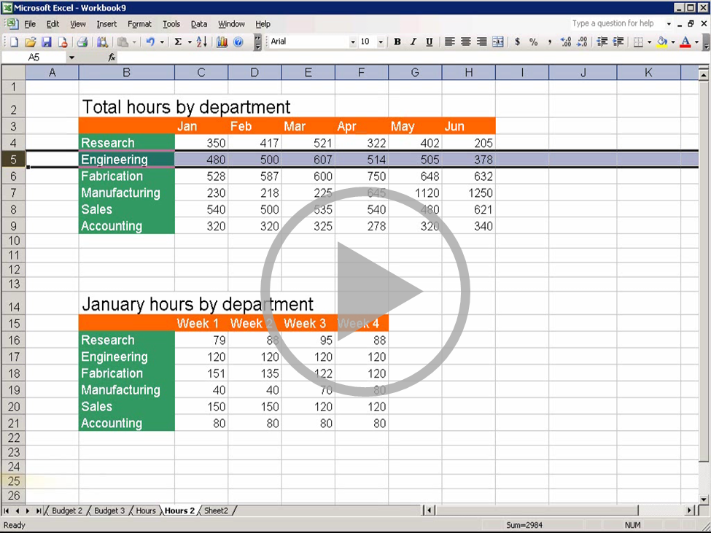
Access keys from previous versions (2:40)
In older versions of Excel, like Excel 2003, you found the access keys by pressing ALT,
For example, ALT+I+R, inserted a row, and ALT+I+C, inserted a column.
In Excel 2010, many access keys changed because the commands and menus were reorganized.
But to help you get used to the new design, the access keys are now displayed in key tips.
However, if you have committed the old access keys to memory, you can still use most of them,
because Excel 2010 was designed to recognize certain key sequences from earlier versions, like ALT+I+R.
Here’s how it works, if you press ALT, then I, Excel 2010 displays a message like this one.
If you run into a situation like this, look on the Ribbon and see what might be a logical choice.
Diagrams were on the Insert menu before, so let’s look on the Insert tab.
I’m not really looking for a chart, but it is a type of illustration, like an org chart, or a flowchart.
Well, it just so happens that the SmartArt button is just what we’re looking for.
So I can press ALT+N+M to add a diagram with SmartArt graphics.
So now you know that the ALT key can also be used for old access keys if you have them memorized.
Up next, learn how to use the ALT key to navigate in dialog boxes.
Let’s go back in time for a bit.
and then looking or underlined letters.
So ALT+H+I+R inserts a row and ALT+H+I+C inserts a column.
If you remember the old key sequence, you can finish it now,
and Excel will perform the command just like it did in 2003.
So we’ll press R and Excel inserts a row.
Let’s do it again, ALT+I+C, still inserts a column.
And ALT+O+E, still opens the Format Cells dialog box.
But not all the old access keys still work.
For example, ALT+I+G, no longer inserts a diagram.
Point to the bottom of the video to see the video controls. Drag or point along the progress bar to move forward or go back.
Notes:
[Note to trainer: If you have trouble playing this video, for instance if a Codec Unavailable message appears in the video playback window, the presentation might have opened in Protected View. To enable video playback, in the yellow security bar at the top of the PowerPoint window, click Enable Editing. Note that even with Protected View turned on, video should play correctly in Slide Show view.]

Slide 7
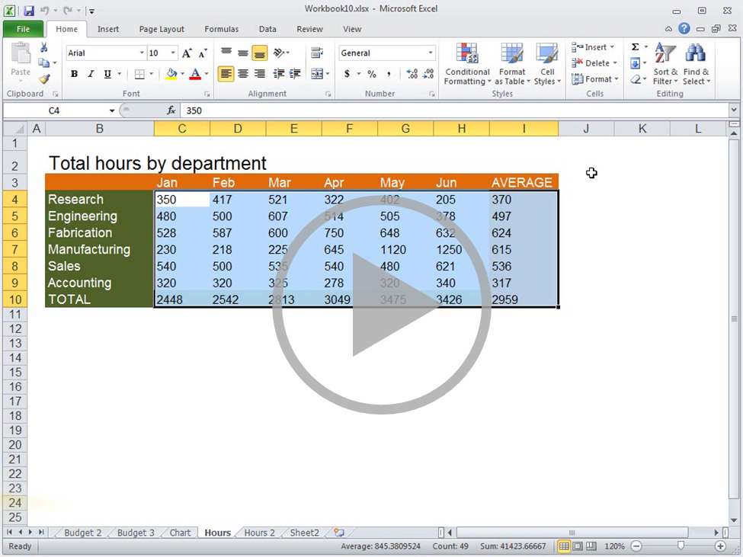
Access keys in dialog boxes (3:28)
or select one of these little arrows in the Ribbon, a dialog box opens.
Instead, press ALT, and you'll find underlined letters like in previous versions of Excel.
If the underlined letter approaches into your liking, you can navigate using the TAB key.
Press TAB to move to the next menu or option, or press SHIFT+TAB to move back.
You'll know an item has a focus if there was a border around it.
If you need to switch tabs in a dialog box, press CTRL and the TAB key to go to the next tab.
Then press TAB to change the focus to the item that you want.
If you need to enter a value use the arrow keys to position the cursor,
If a text box has Up and Down arrows like this one, you can enter a value with the the Up and Down Arrow keys.
If you come across a list, [press SHIFT+TAB], press the Up and Down arrows to open the list, and locate an option,
You can also type the first letter of the option to jump quickly to go to that part of the list.
If you come across a check box, press the Spacebar to select, or clear the option.
As with the Ribbon, you will find yourself using a combination of methods.
For example, you can press ALT+O to select this item, then press the Arrow keys to enter a value.
Okay, so now that we’re all done with the settings in this dialog box, what do we do?
you can press ENTER to accept your changes and close the dialog box.
If you want to discard the changes, you can TAB to the Cancel button and press ENTER, or simply press ESC.
press ENTER to select an option, or use the Up and Down arrows to enter a value.
Now you can do almost anything with the access keys, but is that all? Not quite.
In the next video we'll go through just a few last important tips for you using access keys.
Whenever you select a menu item, that ends with an ellipsis,
You won’t find key tips in dialog boxes.
Select something by pressing ALT and the letter.
and the keyboard to select DEL or type the text or numbers.
then press Enter to select it.
What about check boxes?
Look at the OK and Cancel buttons.
If the OK button is highlighted with a blue border,
Here's another kind of dialog box that you'll run into.
Press the TAB key to change focus to the navigation pane,
then press the Up and Down arrows to select a section,
and then TAB to the value that you want to change,
Point to the bottom of the video to see the video controls. Drag or point along the progress bar to move forward or go back.
Notes:
[Note to trainer: If you have trouble playing this video, for instance if a Codec Unavailable message appears in the video playback window, the presentation might have opened in Protected View. To enable video playback, in the yellow security bar at the top of the PowerPoint window, click Enable Editing. Note that even with Protected View turned on, video should play correctly in Slide Show view.]

Slide 8
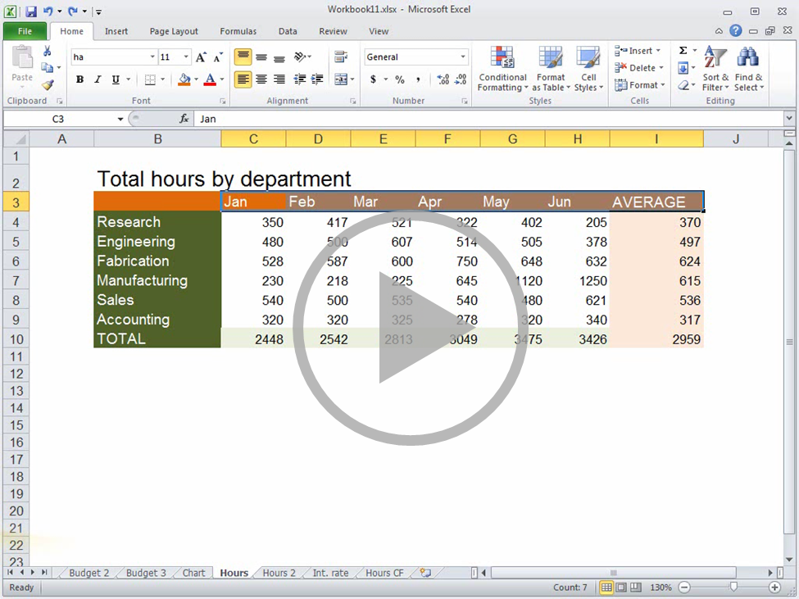
Other kinds of access keys (4:14)
For example you can press R to rename a worksheet or press M to move or copy selected worksheets to an open workbook.
F6 switches focus from the worksheet, to the status bar, to the Ribbon, and then back to the worksheet.
When the focus is on the status bar, you can use the Arrow keys and Enter, to change the view, or zoom level.
If you think of F6 as the key for switching between areas of Excel,
If you’re working with a split worksheet, you can quickly switch between the sections by pressing Shift+F6 and F6.
You probably know how to switch between worksheets using CTRL+Page Up and Page Down.
But if you want to switch between open workbooks, press CTRL F6.
In the first course we taught you that CTRL+Shift+L adds filter buttons to a header row.
But how you access the filters without a mouse? Hold down the ALT key and then press the DOWN arrow.
Select or clear check boxes using the Spacebar, it's just like working in a dialog box.
If you are into saving time, you no doubt use the Right-Click menu. But how can you do that without a mouse?
Easy. Press Shift+F10, then use the Arrow keys and Enter to select an option.
You already saw how to use F2 to enter edit mode with a formula.
For example, locate a function using the access keys for working in dialog boxes, then press Enter.
Now to select the range for the argument Press F2, and the focus switches to the worksheet.
Press Shift and expand the selection to the last cell, then press Enter.
If you use the Function library to insert a formula, F2 works the same way.
Then press Tab or Shift+Tab to switch between arguments, then press Enter.
In fact, F2 works in any dialog box in which you need to add cell references.
You’ve seen how to access just about any button or menu without a mouse,
but there are a few that you can’t get to directly, like this menu that opens when you right-click a sheet tab.
Well, if you need the commands on this menu, you can find them by pressing ALT,
Select the workbook, choose where you want to place the worksheets, create a copy if you want, and press Enter.
In this course, you learned how to get around in Excel using access keys instead of a mouse.
If you haven’t already take Excel 2010 keyboard shortcuts I, to find out how to work faster using key combinations.
If you want a printable list of all keyboard shortcuts, see the Quick Reference Card at the end of this course.
So far we have talked about how to use ALT keys quite a bit,
but there are other kinds of access keys to know about.
The first one is F6.
it'll be easy to remember the variations, Shift+F6.
Release the ALT key, and use the arrows to select an option.
Another one to know about is F2.
But F2 is also useful for creating a formula in a dialog box.
Use the ARROW keys to select the first cell in the range.
Press F2 to switch focus to the worksheet and locate a cell.
Like this one for editing conditional formatting rules.
then go to the Home tab and open the Format menu.
Point to the bottom of the video to see the video controls. Drag or point along the progress bar to move forward or go back.
Notes:
[Note to trainer: If you have trouble playing this video, for instance if a Codec Unavailable message appears in the video playback window, the presentation might have opened in Protected View. To enable video playback, in the yellow security bar at the top of the PowerPoint window, click Enable Editing. Note that even with Protected View turned on, video should play correctly in Slide Show view.]

Slide 9
Quick Reference Card 1
Access the ribbon
Press ALT. The KeyTips are displayed over each feature that is available in the current view.
Press the letter shown in the KeyTip over the tab that you want to use.
Depending on which letter you press, you may be shown additional KeyTips. For example, if the Home tab is active and you press N, the Insert tab is displayed, along with the KeyTips for the groups on that tab.
Continue pressing letters until you press the letter of the command or control that you want to use.
Note To cancel the action that you are taking and hide the KeyTips, press ESC.

Slide 10
Quick Reference Card 2
To do this | Press
Switches from the worksheet, to the status bar, to the ribbon, back to worksheet | F6
Switch between panes in a split worksheet | F6, SHIFT+F6
Switch between open workbooks in the same instance of Excel | CTRL+F6
Add filter buttons | CTRL+SHIFT+L
Access filter menus | ALT+Down arrow
Select or clear check boxes | Spacebar
Access the right-click menu | SHIFT+F10
In the Function Arguments dialog box, switch from the dialog box to the worksheet | F2

